Slide 1
Catalysts and Reaction Rates
April 19

Slide 2
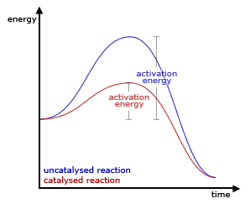
What is a catalyst?
Watch the video: What are catalysts? Chemistry for all.
https://www.youtube.com/watch?v=m_9bpZep1QM

Slide 3
Watch the Demo
Figure out what substance is the catalyst?
Hydrogen Peroxide (6%), Dawn soap, Yeast, Oxygen, Water

Slide 4
Review
Complete the following activities:
Factors Chart
Graphic Organizer
(get the key for 1.+2. when table is done)
3. Concept Attainment Quiz (online)
4. Independent Practice (online)
HW: what is not completed in class

